Slide 1
NBKR Institute Of Science and Technology
Inventory Tracker for Stationery Shop in C
Punamalli venkata Kumar 24KB1A05FF

Slide 2

Inventory Tracker for Stationery Shop in C
This presentation covers the development of an inventory tracker application designed specifically for a stationery shop. Implemented in C language, this program manages stock items, updates quantities, and calculates the total inventory value.
The system provides a command-line interface for adding new items, updating existing stock, displaying current inventory, and evaluating overall asset worth, showcasing practical use of linked lists and dynamic memory in C.

Slide 3
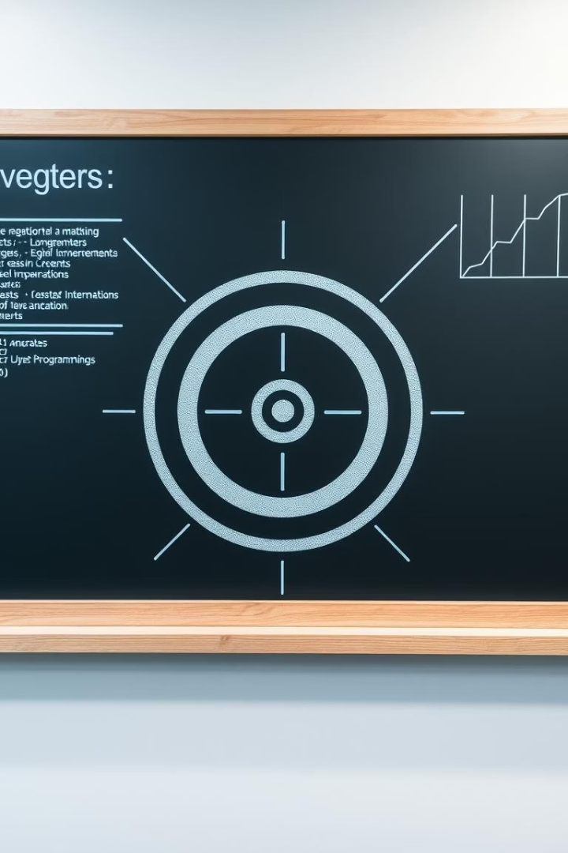
Project Objective
Efficient Inventory Management
Dynamic Data Handling
Streamline the tracking of stationery items including name, quantity, and price.
Utilize dynamic structures to flexibly accommodate changing inventory sizes without fixed limits.
User-Friendly Interface
Provide console-based interaction for ease of use and quick data manipulation.

Slide 4
Why Use C and Data Structures?
Why C?
Data Structures Used
Efficient memory management
Linked lists for dynamic inventory records
Close-to-hardware control ideal for system-level programming
Simple structs for item representation
Dynamic memory allocation for flexible inventory size
Widely used in embedded and performance-critical applications

Slide 5
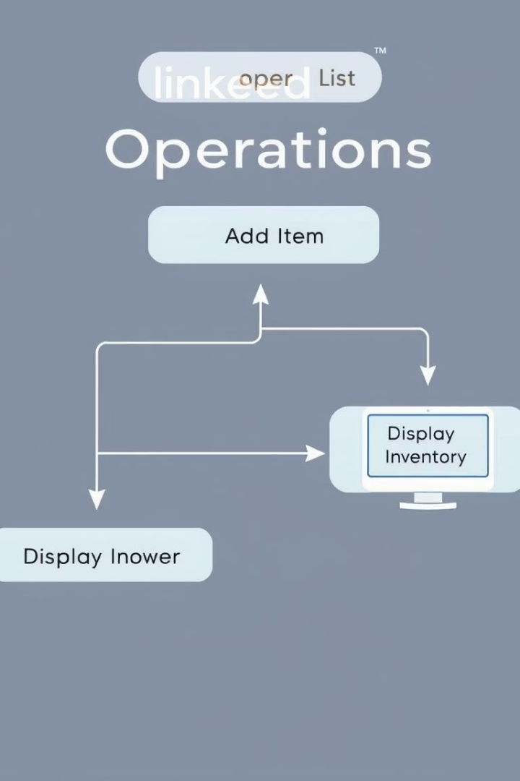




Key Algorithm and Implementation Details
Add Item
Create a new inventory node and insert it at the start of the linked list.
Update Stock
Traverse the list to locate the item and adjust its quantity accordingly.
Calculate Inventory Value
Iterate over all items, aggregating the product of quantity and price.
Display Inventory
Sequentially print the name, quantity, and price of each item to the console.

Slide 6

Lessons Learned from the Project
Memory Management
Handling dynamic memory with malloc requires careful allocation and release to avoid leaks.
Linked List Traversal
Efficient traversal and update logic are crucial for maintaining data integrity and accuracy.
User Interaction
Simple input validation and clear prompts enhance usability in console applications.
Modular Design
Separating functionalities into discrete functions improves maintainability and testing.

Slide 7
Code Structure Overview
Struct Definition
Functions
Holds item name, quantity, price, and pointer to the next item enabling linked list chaining.
createItem: Allocates and initializes item nodes
addItem: Inserts new nodes at the list head
updateStock: Adjusts quantity for existing items
calculateInventoryValue: Aggregates total monetary value
displayInventory: Prints inventory table to console

Slide 8
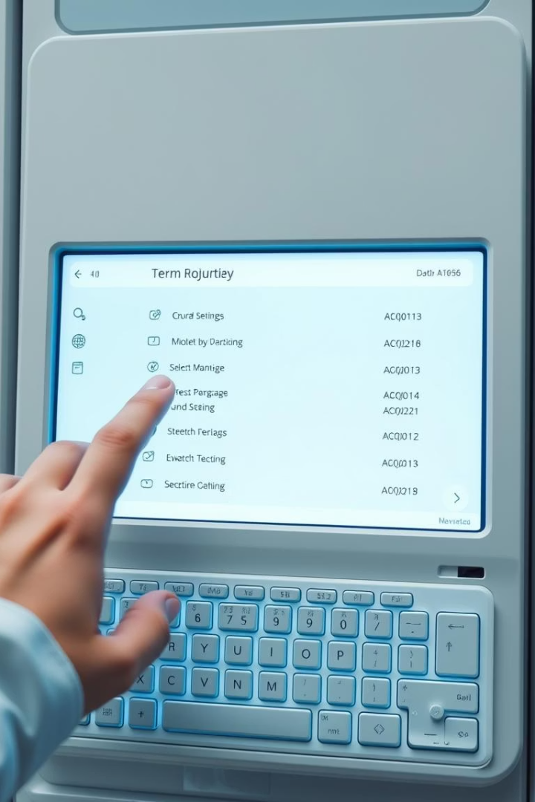
User Interface and Program Flow
1
Menu Display
Shows options: Add Item, Update Stock, Display Inventory, Calculate Value, Exit.
2
User Input Handling
Reads user selections and relevant data via console input.
3
Action Execution
Calls corresponding function for each menu choice with error checks.
4
Loop Control
Continues until user explicitly chooses to exit.

Slide 9
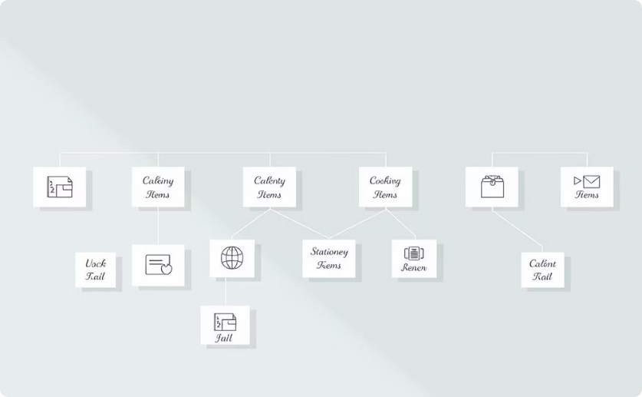
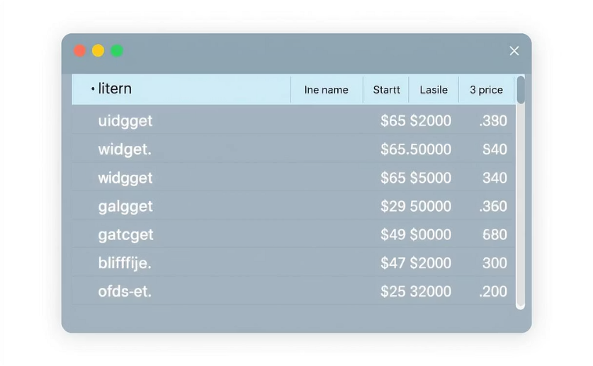
Visual Representation of Inventory Data
Data Structure Visualization
Inventory Table Output
Shows how each list node contains item data and a pointer to the next item, representing the inventory chain.
Demonstrates formatted printout of current items for quick user reference.

Slide 10
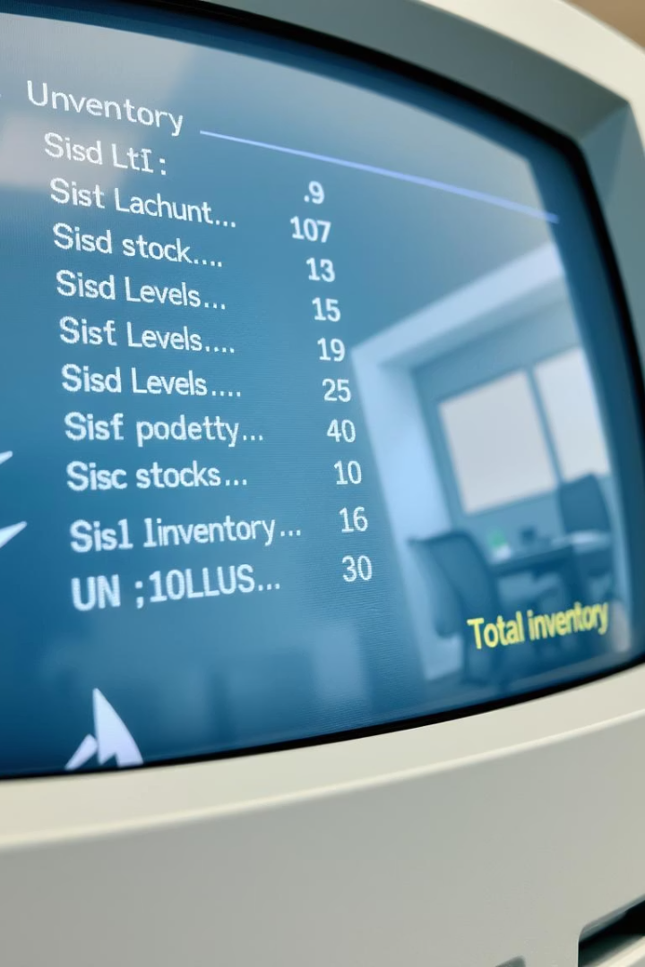
Sample Program Output
Add Item
Shows confirmation after adding 'Pen' with quantity 100 and price ₹5.50.
Update Stock
Updates quantity of 'Pen' by adding 50 units, with confirmation displayed.
Display Inventory
Presents current list with items, quantities, and prices in tabular form.
Calculate Total Value
Outputs the cumulative monetary value of all inventory items.

Slide 11

Summary and Next Steps
Project Summary
Potential Enhancements
Implemented a dynamic C program tracking stationery items using linked lists, supporting key operations and calculations.
Extend with file I/O for persistent storage, implement deletion of items, enhance user input validation.
Conclusion
This project demonstrates practical use of pointers, structs, and dynamic memory in C to solve real-world inventory challenges.

